Slide 1
SENG2260 Human-Computer Interaction
Week 9a: Introducing Evaluation
All images in this presentation are either licenced or labelled for reuse on Google Images.

Slide 2
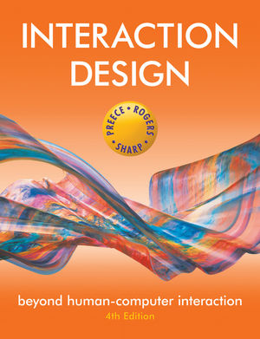
Chapter 13
Introducing Evaluation

Slide 3
The aims
Explain the key concepts and terms used in evaluation
Introduce different types of evaluation methods.
Show how different evaluation methods are used for different purposes at different stages of the design process and in different contexts of use.
Show how evaluators mix and modify methods to meet the demands of evaluating novel systems.
Discuss some of the challenges that evaluators have to consider when doing evaluation.
Illustrate how methods discussed in lectures 7 and 8 are used in evaluation and describe some methods that are specific to evaluation.
Notes:
3

Slide 4
Why, what, where and when to evaluate
Iterative design & evaluation is a continuous process that examines:
Why: to check users’ requirements and that they can use the product and they like it.
What: a conceptual model, early prototypes of a new system and later, more complete prototypes.
Where: in natural and laboratory settings.
When: throughout design; finished products can be evaluated to collect information to inform new products.
Notes:
4

Slide 5
Bruce Tognazzini tells you why you need to evaluate
“Iterative design, with its repeating cycle of design and testing, is the only validated methodology in existence that will consistently produce successful results. If you don’t have user-testing as an integral part of your design process you are going to throw buckets of money down the drain.”
See AskTog.com for topical discussions about design and evaluation.
Notes:
5

Slide 6
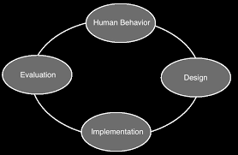
Types of evaluation
Controlled settings involving users, e.g. usability testing & experiments in laboratories and living labs.
Natural settings involving users, e.g. field studies and in the wild studies to see how the product is used in the real world.
Settings not involving users, e.g. to predict, analyze & model aspects of the interface analytics.

Slide 7
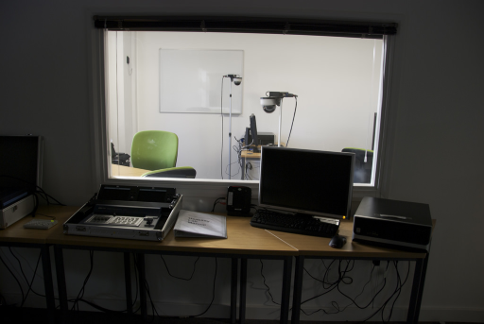
Living labs
People’s use of technology in their everyday lives can be evaluated in living labs.
Such evaluations are too difficult to do in a usability lab.
E.g. the Aware Home was embedded with a complex network of sensors and audio/video recording devices (Abowd et al., 2000).

Slide 8
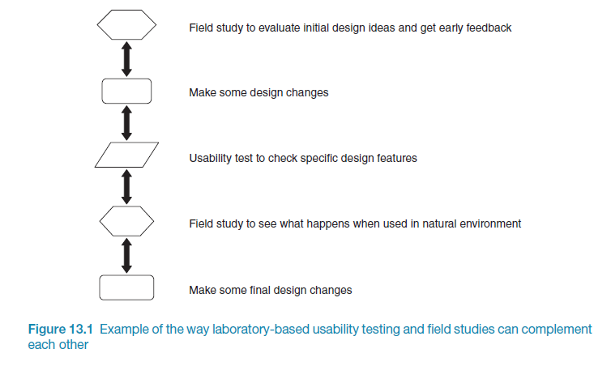
Usability testing & field studies can compliment

Slide 9
Evaluation case studies
Experiment to investigate a computer game
In the wild field study of skiers
Crowdsourcing
Notes:
9

Slide 10
Challenge & engagement in a collaborative immersive game
Physiological measures were used.
Players were more engaged when playing against another person than when playing against a computer.
What precautionary measures should the evaluators take?
Notes:
10

Slide 11
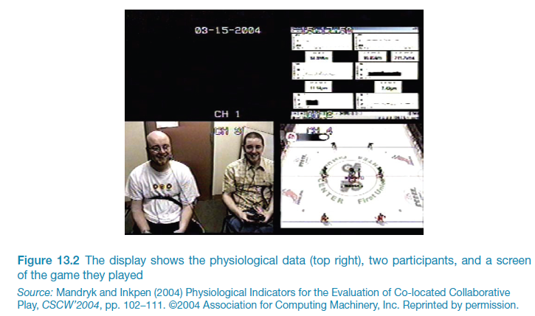
Challenge & engagement in a collaborative immersive game
Notes:
11

Slide 12
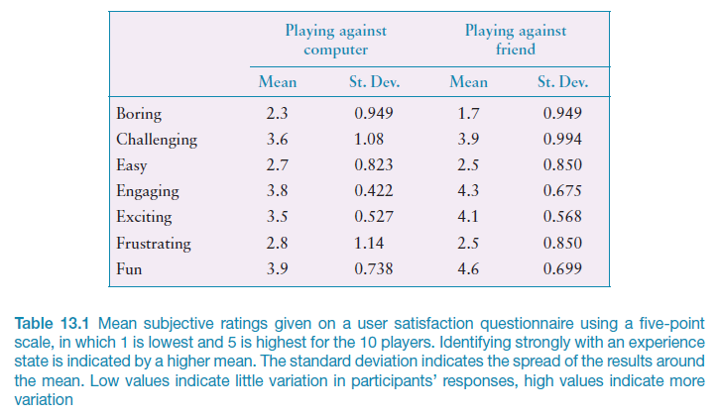
What does this data tell you?
Notes:
12

Slide 13
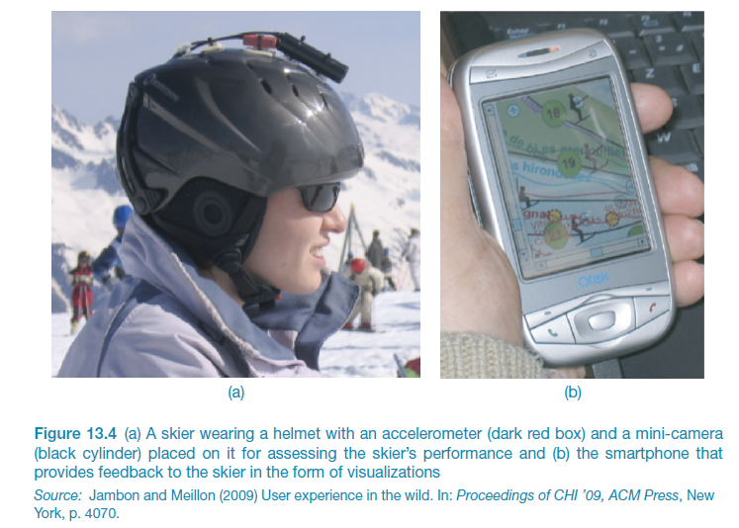
Why study skiers in the wild?

Slide 14
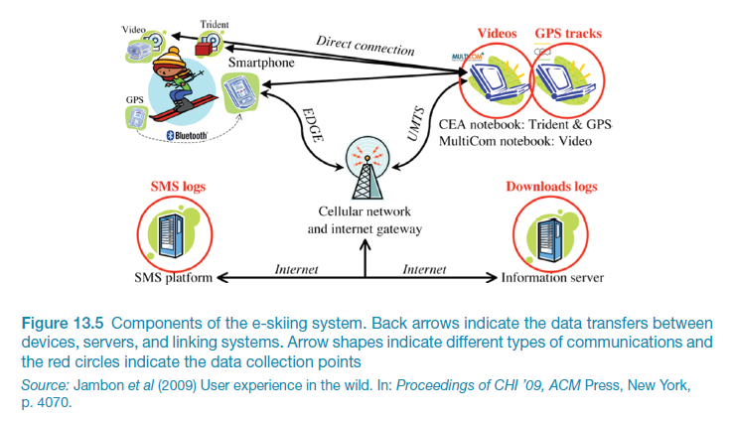
e-skiing system components

Slide 15
Why study skiers in the wild ?

Slide 16
Crowdsourcing
What if we need large numbers of participants?
Mechanical Turk (hosted by Amazon) has thousands of people registered to perform online tasks (for a small reward)
Tagging pictures
Online experiments
Similar results to lab experiments and lower cost

Slide 17
What did we learn from the case studies?
How to observe users in natural settings.
Unexpected findings resulting from in the wild studies.
Having to develop different data collection and analysis techniques to evaluate user experience goals such as challenge and engagement.
The ability to run experiments on the Internet that are quick and inexpensive using crowdsourcing.
How to recruit a large number of participants using Mechanical Turk.Test text

Slide 18
Evaluation methods
Method | Controlled settings | Natural settings | Without users
Observing | x | x
Asking users | x | x
Asking experts |  | x | x
Testing | x
Modeling |  |  | x
Notes:
18

Slide 19
The language of evaluation
Analytics
Analytical evaluation
Biases
Controlled experiment
Crowdsourcing
Ecological validity
Expert review or crit
Field study
Formative evaluation
Heuristic evaluation
Informed consent form
In the wild evaluation
Living laboratory
Predictive evaluation
Reliability
Scope
Summative evaluation
Usability laboratory
User studies
Usability testing
Users or participants
Validity
Notes:
19

Slide 20
Participants’ rights and getting their consent
Participants need to be told why the evaluation is being done, what they will be asked to do and their rights.
Informed consent forms provide this information.
The design of the informed consent form, the evaluation process, data analysis and data storage methods are typically approved by a high authority, eg. Institutional Review Board.
UON HREC
National HREA (WHY)

Slide 21
Things to consider when interpreting data
Reliability: does the method produce the same results on separate occasions?
Validity: does the method measure what it is intended to measure?
Ecological validity: does the environment of the evaluation distort the results?
Biases: Are there biases that distort the results?
Scope: How generalizable are the results?

Slide 22
Key points
Evaluation and design are very closely integrated.
Some of the same data gathering methods are used in evaluation as for establishing requirements and identifying users’ needs, e.g. observation, interviews, and questionnaires.
Evaluations can be done in controlled settings such as laboratories, less controlled field settings, or where users are not present.
Usability testing and experiments enable the evaluator to have a high level of control over what gets tested, whereas evaluators typically impose little or no control on participants in field studies.

Slide 23
You should now...
Know the key concepts and terms used in evaluation
Be aware of ways evaluators mix and modify methods to meet different evaluation demands
Be able to discuss challenges that evaluators have to consider when planning and conducting evaluations
Know how data gathering and data analysis support and compliment evaluation activities

